Slide 1


UNDERSTAND CUSTOMER & MARKET FIT
WEEK 4

Slide 2
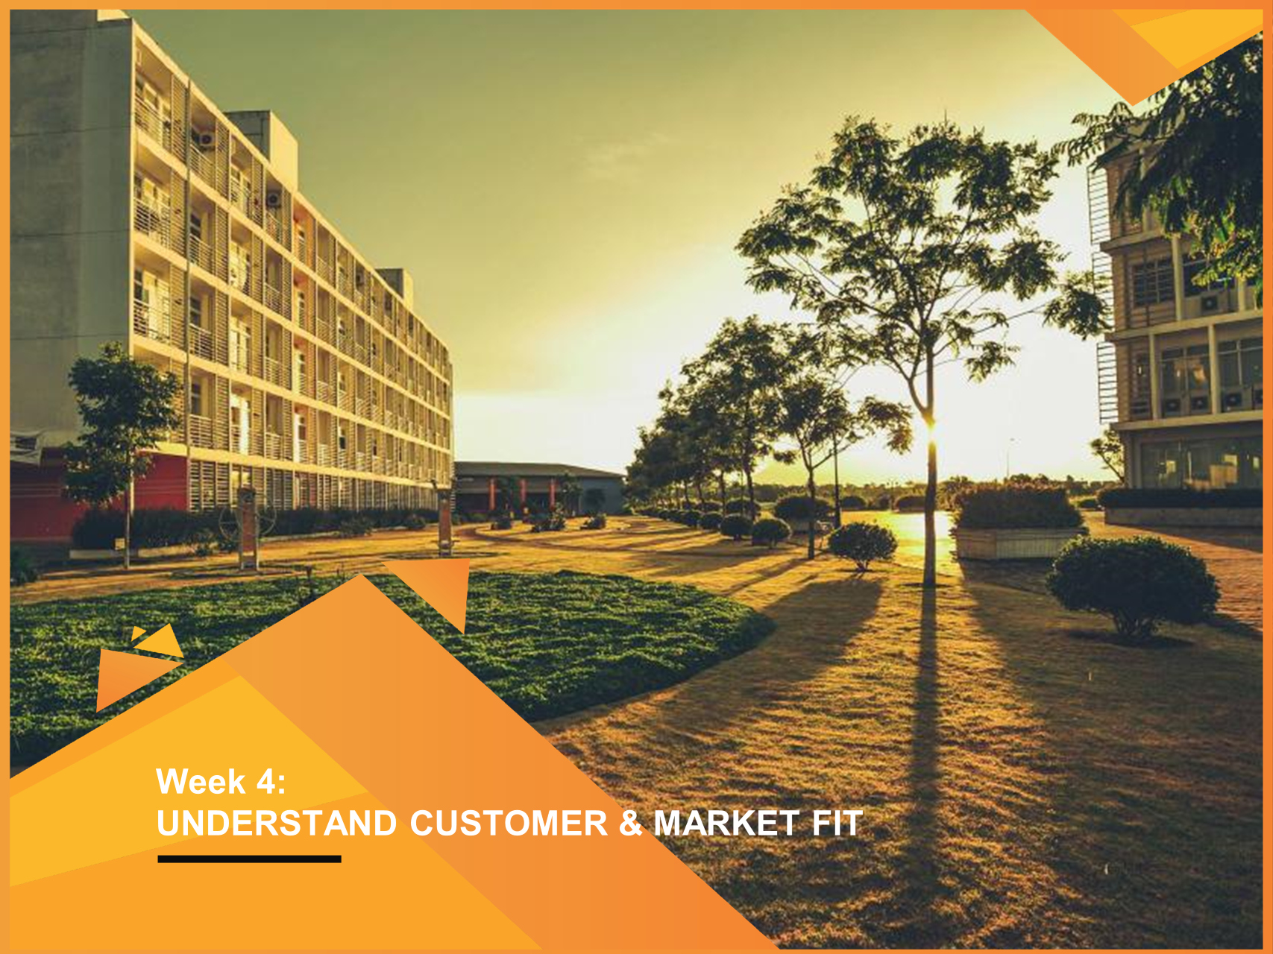
UNDERSTAND CUSTOMER & MARKET FIT
WEEK 4

Slide 3
LEARNING OBJECTIVES
LO1: To understand the differences between creativity and innovation
LO2: To know types of innovation
LO3: To understand and apply the Value Proposition Canvas model (VPC)
LO4: To understand approaches evaluating entrepreneurial opportunities
LO5: To determine critical factors involved in assessing an opportunity
LO6: Porter’s 5 forces and PESTEL framework

Slide 4
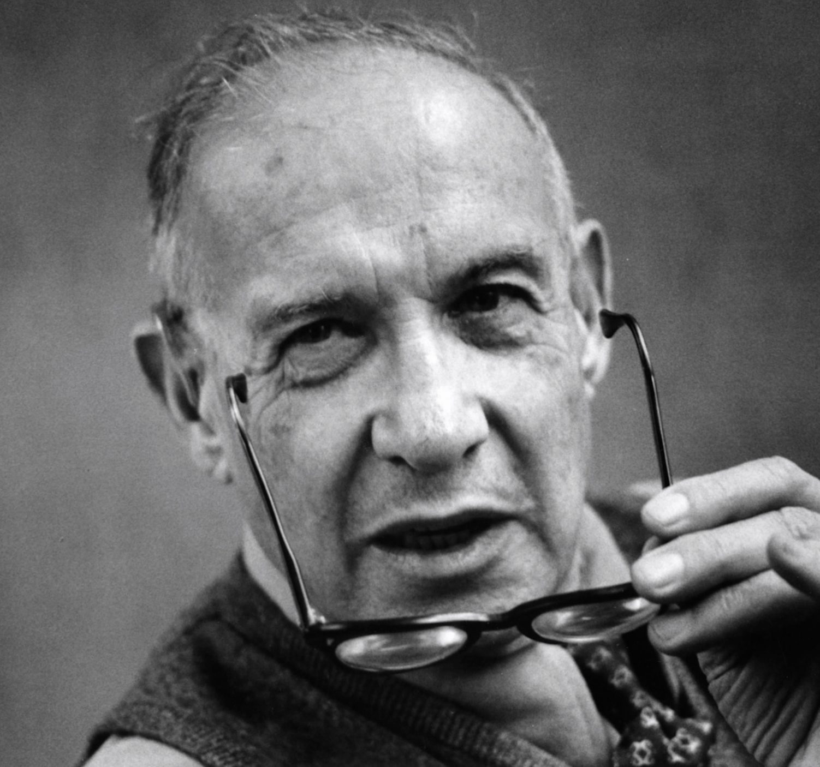
CREATIVITY & INNOVATION
“Entrepreneurs innovate. Innovation is the specific instrument of entrepreneurship. It is the act that endows resources with a new capacity to create wealth”.
Peter F. Drucker “Innovation and Entrepreneurship”

Slide 5
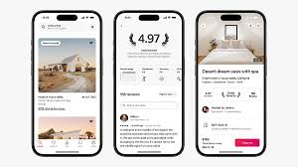
CREATIVITY & INNOVATION
AirBnb did not invent a new technology like: Mobile app, GPS, 3G, map integration, or online payment system
They simply found new uses for these technologies
“It is the act that endows resources with a new capacity to create wealth” – Peter Drucker

Slide 6


CREATIVITY & INNOVATION
FOR A CREATIVE IDEA TO BE AN INNOVATION, IT NEEDS TO:LI
Address specific problems or needs
Create opportunities that add value or drive positive changes

Slide 7

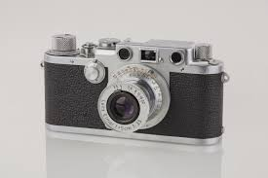
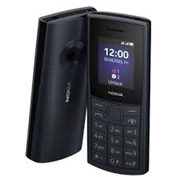
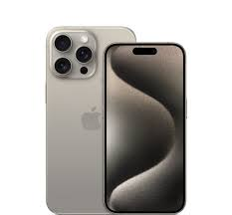
CREATIVITY & INNOVATION
Meet a need/opportunity in the market
INNOVATION
Generate novel ideas
Turning innovative solutions into marketable products/services
Turning creative ideas into solutions or value
+
CREATIVITY
ENTREPRENEURSHIP
Solve problems and create value

Slide 8
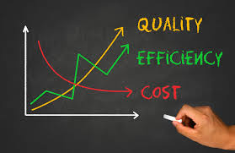
CREATIVITY & INNOVATION
Do you think your innovation can become a marketable product?
FROM INNOVATION TO A MARKETABLE PRODUCT
CAN YOU PRODUCE IT AT ACCEPTABLE COSTS
ARE CUSTOMERS WILLING TO BUY IT?
ARE THERE MANY OF THEM?
CAN YOU SELL IT AT A PROFITABLE PRICE?
REACH CUSTOMERS IN A COST-EFFICIENT WAY?
Entrepreneurial opportunity

Slide 9
CREATIVITY & INNOVATION
FOUR BASIC TYPES OF INNOVATION
(PETER DRUCKER THEORY)
1. Invention
Totally new product, service, or process: the invention of the telephone, bulb, etc
2. Extension
New use or different application of existing product, service or process: Facebook
3. Duplication
Creative replication of an existing concept: Grab replicates the Uber model by catering to the Southeast Asia region
4. Synthesis
Combination of existing concepts and factors into a new formulation or use: Smartwatch, smartphone, etc

Slide 10
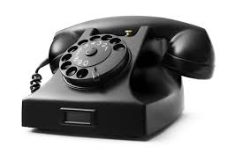
CREATIVITY & INNOVATION
INVENTION
Before the telephone, there wasn't a way to transmit voice conversations instantly over long distances. The telephone addressed this need and revolutionized communication.

Slide 11

CREATIVITY & INNOVATION
EXTENSION
Before Facebook, there were some forums/communities in universities, clubs, etc locally used to connect members/students, but the occurrence of FB has helped develop this connection to another stage worldwide

Slide 12

CREATIVITY & INNOVATION
DUPLICATION
Grab replicates the ride-hailing app model pioneered by Uber, and it caters to the specific needs of the Southeast Asia region only.

Slide 13
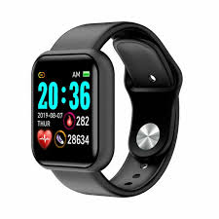
CREATIVITY & INNOVATION
SYNTHESIS
Smartwatch synthesizes functions/features previously found in separate devices like a smartphone, and watch

Slide 14
ENTREPRENEURIAL OPPORTUNITIES
WHAT IS AN ENTREPRENEURIAL OPPORTUNITY?
An opportunity is an idea that is evaluated as being able to create value for others and a market can be realized
(Nielsen, Klyver, Evald & Bager, 2021)
An entrepreneurial opportunity occurs when an entrepreneur recognizes and validates the potential of a product and/or service that solves a real-world pain, or adds value for a customer
(Frederick, O'connor & Kuratko, 2016)

Slide 15



ENTREPRENEURIAL OPPORTUNITIES
IDEAS AND OPPORTUNITIES
Is this a potential entrepreneurial opportunity or a mere idea not worth pursuing
Entrepreneurs are often particularly good at identifying or generating new ideas
Not all ideas can grow and turn into opportunities
As an entrepreneur, you need to be good at not only generating new ideas but also at evaluating if an idea is a good entrepreneurial opportunity
Evaluation is the key to differentiating an idea from an opportunity

Slide 16


ENTREPRENEURIAL OPPORTUNITIES
AN IDEA = PROBLEM + SOLUTION
Real-world pain
Problem/need
Solve the problem
Solution
Satisfy the need
Car owners (supply) love to have some extra earnings during their free time
Passengers (demand) love to have different transportation vehicles and convenience at reasonable prices provided in advance when booking
A transportation application connects the demand with supply.

Slide 17

ENTREPRENEURIAL OPPORTUNITIES
AN IDEA = PROBLEM + SOLUTION
Real-world pain
Problem/need
Solve the problem
Solution
Satisfy the need
House owners (supply) love to have some extra earnings for their available rooms
Tourists (demand) love to have different choices and convenience at reasonable prices provided in advance when booking
A tourist booking application connects the demand with supply.

Slide 18
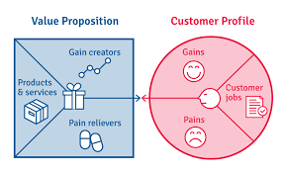
VALUE PROPOSITION CANVAS MODEL (VPC)
How your product creates value for customers
Source: developed by Alexander Osterwalder

Slide 19
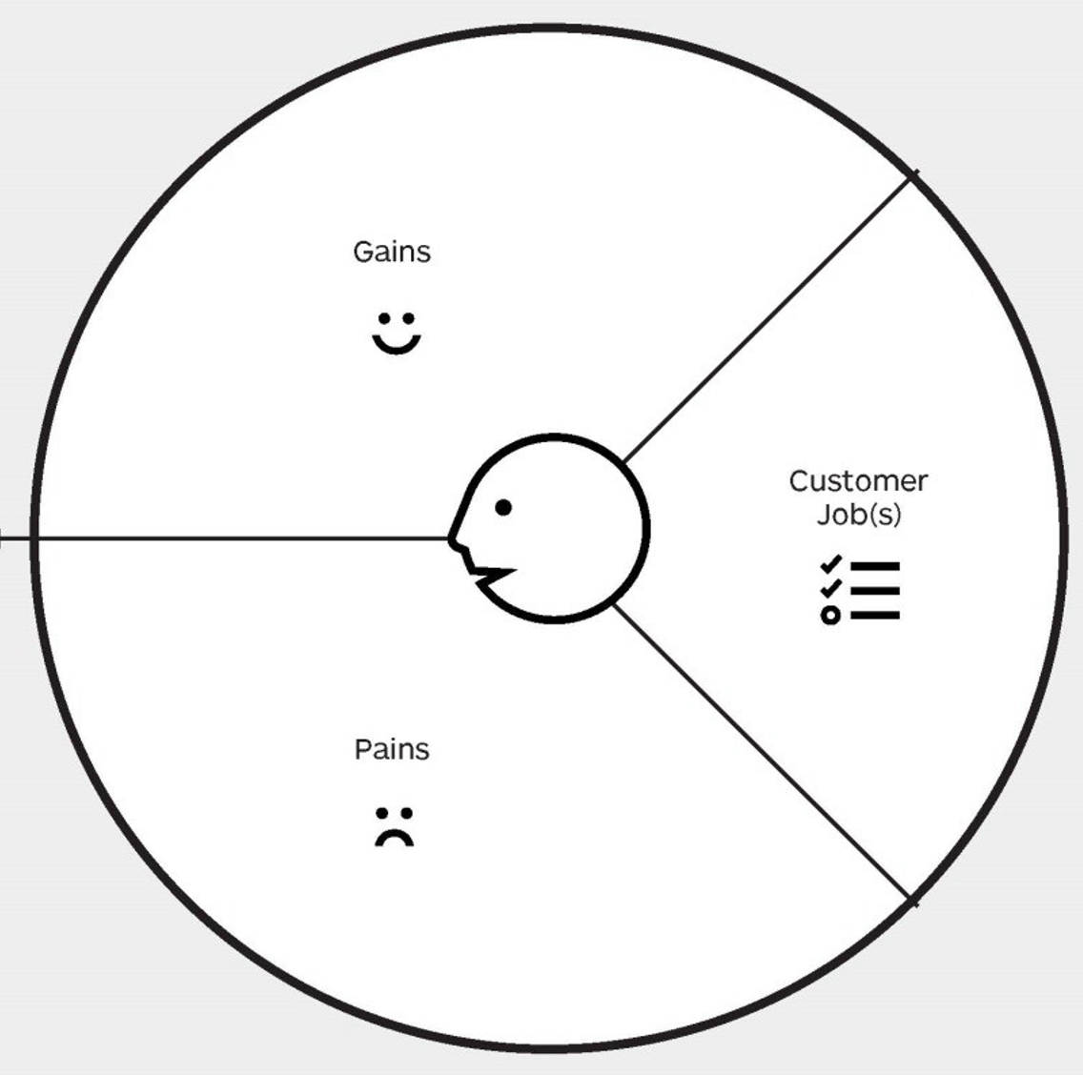
VALUE PROPOSITION CANVAS MODEL (VPC)
What motivates your customers? And the reasons they buy or use your product?
﻿Gains describe the outcomes customers want to achieve or the concrete benefits they are seeking.
﻿A customer job could be the tasks they are trying to perform and complete, the problems they are trying to solve, or the needs they are trying to satisfy.
﻿Functional jobs
﻿Social jobs
﻿Emotional jobs
﻿Pains describe bad outcomes, risks, and obstacles related to customer jobs.

Slide 20
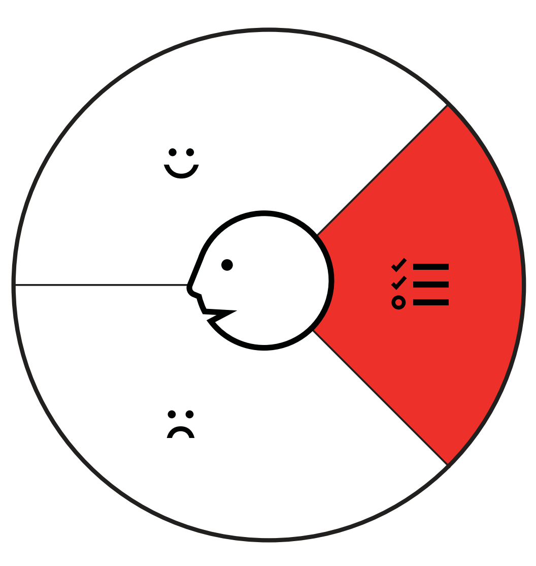
CASE STUDY: UBER
Customer jobs: Customers use Uber to:
Book rides quickly
Track their drivers’ location
Pay for their trips seamlessly,
Save time and reduce the hassle of traditional taxi services.
Uber focuses on functional jobs such as transportation convenience and efficiency

Slide 21

CASE STUDY: UBER
Customer Pains include:
Long wait times for rides
Uncertainty about driver availability.
Concerns about safety and security during their journeys

Slide 22

CASE STUDY: UBER
Customer Gains: Uber offers customers:
The convenience of on-demand transportation
The assurance of transparent pricing and payment options
The peace of mind of tracking their rides in real-time.

Slide 23
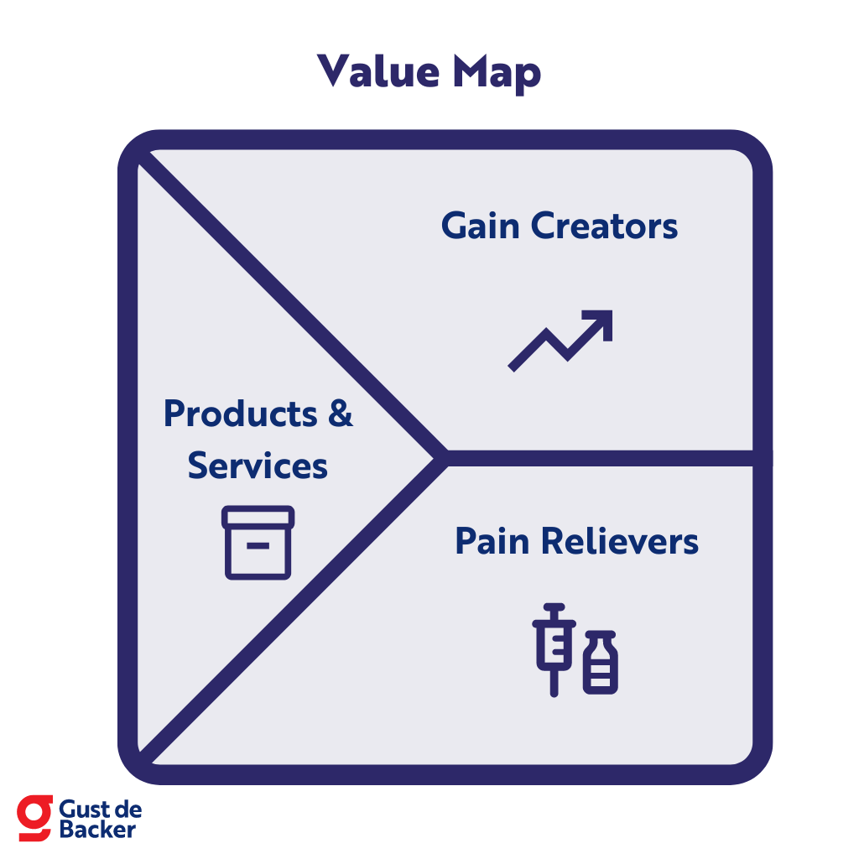
CASE STUDY: UBER
How your product creates value for customers
Gain creators include features like upfront pricing, ride-sharing options for cost savings, and personalized promotions for customer loyalty
Pain relievers such as real-time ride tracking, driver ratings for safety assurance, and flexible payment options.

Slide 24
EVALUATION AN ENTREPRENEURIAL OPPORTUNITIES
The evaluation aims to determine whether the concept is a viable future option in a market that may not yet exist.
Thus, this makes the evaluation of idea difficult to anticipate
It’s a forward-looking evaluation
﻿It’s about examining whether the idea can form the basis for a profitable and sustainable business

Slide 25
EVALUATION AN ENTREPRENEURIAL OPPORTUNITIES
INSTRUMENTAL VERSUS LEGITIMATE APPROACH TO EVALUATION
Instrumental perspective: Using tools and techniques to systematically evaluate the potential of an opportunity
Legitimate evaluation: a continuous process through which entrepreneurs create legitimacy for themselves by convincing others about the idea’s viability and continuing to refine the idea based on other’s feedback.

Slide 26
EVALUATION AN ENTREPRENEURIAL OPPORTUNITIES
INSTRUMENTAL APPROACH - CRITICAL FACTORS IN ASSESSING AN OPPORTUNITY
Product Uniqueness: What makes your product unique or different compared to existing market options?
Customer Availability: Who are your customers and are they willing to pay for your product?
Product Availability: Is your product ready for use or still in development?
Investment: How much initial capital is needed before seeing a profit?
Growth of Sales: How fast do you expect your sales and profits to grow?
Source: Frederick et al., 2016

Slide 27
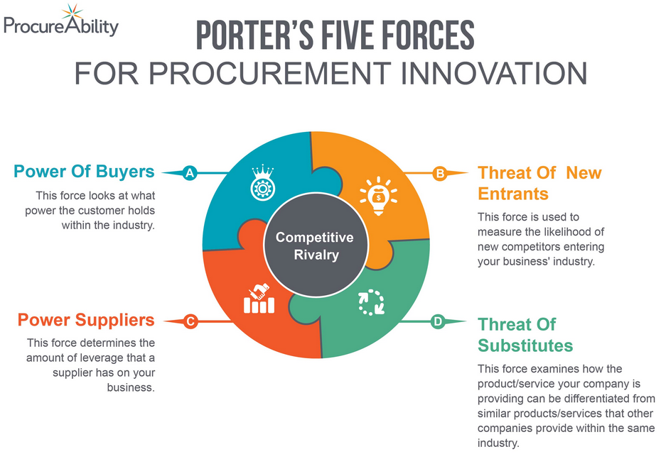
EVALUATION AN ENTREPRENEURIAL OPPORTUNITIES
INSTRUMENTAL APPROACH – PORTER’S 5 FORCES
Source: developed by Porter

Slide 28
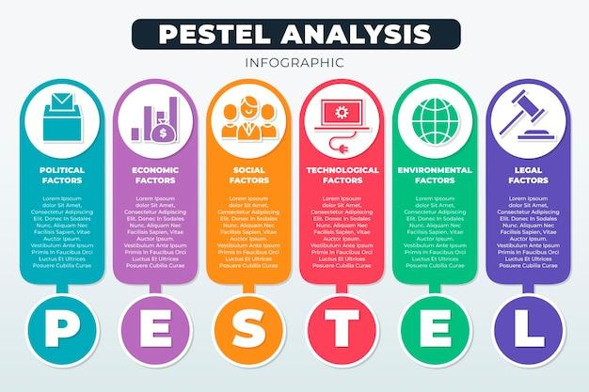
EVALUATION AN ENTREPRENEURIAL OPPORTUNITIES

Slide 29
KEY TAKEAWAY
KA1: To understand the differences between creativity and innovation, and types of innovation
KA 2: To understand and apply the Value Proposition Canvas model (VPC)
KA 3: To understand the instrumental and legitimate approaches when evaluating entrepreneurial opportunities
KA 4: To determine critical factors involved in assessing an opportunity
KA 5: To understand the Porter’s 5 forces & PESTEL framework, and how to use them in assessing entrepreneurial opportunities

Slide 30
REFERENCE VIDEOS
a) How to Get and Test Ideas (Link: https://www.ycombinator.com/library/7x-how-to-get-and-test-ideas)
b) How to Evaluate Startup Ideas (Link: https://www.ycombinator.com/library/6e-how-to-evaluate-startup-ideas)
c) How to Measure (Link: https://www.ycombinator.com/library/6e-how-to-evaluate-startup-ideas)
a) How to Talk to Users (Link: https://www.ycombinator.com/library/6g-how-to-talk-to-users)
b) How to Find Product-Market Fit (Link: https://www.ycombinator.com/library/7V-how-to-find-product-market-fit-sus-201
Drucker, P., & Maciariello, J. (2014). Innovation and entrepreneurship. Routledge.

Slide 31



